Slide 1
A MODULAR AGRICULTURE SYSTEM
Muhammad Haziq Saleem, Ahsan Ashraf & Muhammad Saad Wasif
2nd Year, Electrical Engineering – NEDUET
September 28th 2018
Notes:
We designed this template so that each member of the project team has a set of slides with its own theme. Members, here’s how you add a new slide to just your set:
Mark where you want to add the slide: Select an existing one in the Thumbnails pane, click the New Slide button, then choose a layout. The new slide gets the same theme as the other slides in your set.
Careful! Don’t annoy your fellow presenters by accidentally changing their themes. That can happen if you choose a different theme from the Design tab, which changes all of the slides in the presentation to that look.

Slide 2
Table Of Contents
What is Precision Agriculture
Precision Irrigation
Project Description
Block Diagram
Block Diagram Explanation
Current Status
Path Forward
Timeline

Slide 3
What is Precision Agriculture?
Precision Agriculture (PA) is the application of IoT (Internet of Things) in agriculture. The basic purpose of using Precision Agriculture is to avoid the wastage of resources and increasing yield, sustainability and productivity of crops

Slide 4
Precision Irrigation
It is a sub-domain of Precision Agriculture.
Crop Irrigation requirements may vary with changing environment. Precision Irrigation provide means for evaluating crop’s water requirements and means for applying the right amount of water at the right time.

Slide 5
Project Description
In our project we aim at monitoring the crops and achieving precision irrigation.
This is done by controlling a water valve using arduino (based on the readings from various sensors in probe).
Sensor data is also logged in a database and shown graphically on a User Interface.

Slide 6

System Block Diagram
User Interface
Database
Probe
Probe
Probe
Server
Field
Hub

Slide 7
Probe
Probes are installed in the field. It is the platform which contains all the sensors and a microcontroller.
The sensors are connected to a microcontroller board “LoRaduino”.
This collected data is processed in LoRaduino.
Processed data is transmitted to the communication hub through a built-in radio transmitter.

Slide 8
Probe Block Diagram
µController
Soil Temperature Sensor
Humidity Sensor (DHT11)
Photoresistor
LoRa RF-95 Wireless Transmitter
Moisture Sensor
LoRaduino

Slide 9
Communication Hub
It is situated in the field (within the distance range of the probes’ radio transmitter).
Communication Hub also contains a LoRaduino microcontroller.
Built-in radio receiver is used to receive data from the probes which are transmitting data from the field.
A Wi-Fi module is connected to LoRaduino.
Sensor data is sent to the database by using the Wi-Fi Module.

Slide 10
Hub Block Diagram
RF-Wireless Receiver
NodeMCU
µController
LoRaduino

Slide 11

Water Valve
It contains a solenoid water valve which is controlled by a relay.
The hub’s microcontroller(based upon sensor values/based upon time intervals) switches the relay on/off.
Hub
Water Valve

Slide 12
Database
For the purpose of this project we are using MySQL database management system based on SQL database language to store our data transmitted from communication hub
Wi-Fi Module (ESP8266) in communication hub is transmitting readings of different probes to MySQL Database which is then used by User Interface for analysis purpose.

Slide 13
User Interface
In order to display analyzed data we need a user interface that is a website which displays separate graphs of Temperature, Humidity and Moisture with respect to time.
Also it will display the current values of these three parameters in each probe.
Future predictions can be made after analysis of collected data from probe.

Slide 14
Block Diagram Of User Interface
MySQL
Python
JavaScript
Database
Backend
Charts
Frontend
HTML/CSS

Slide 15
Current Status
So far we have achieved,
Sensor Interfacing.
Wireless connection between the Field node and Hub.
Created MySQL database for sensor’s readings.
Plotting of data using chart.js library.
Created a Website for displaying sensor readings and graphs over the period of time for analysis purpose.

Slide 16
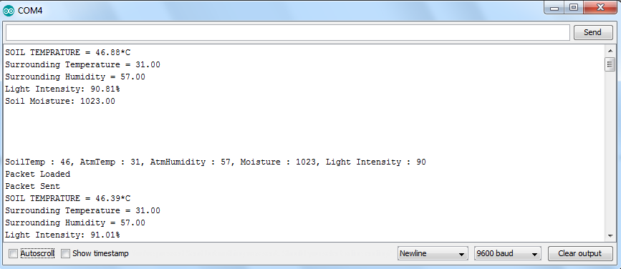
Sensor interfacing and data transmission

Slide 17
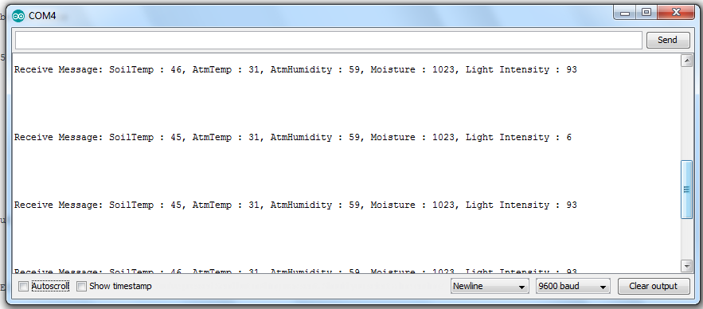
Data received at the Hub

Slide 18
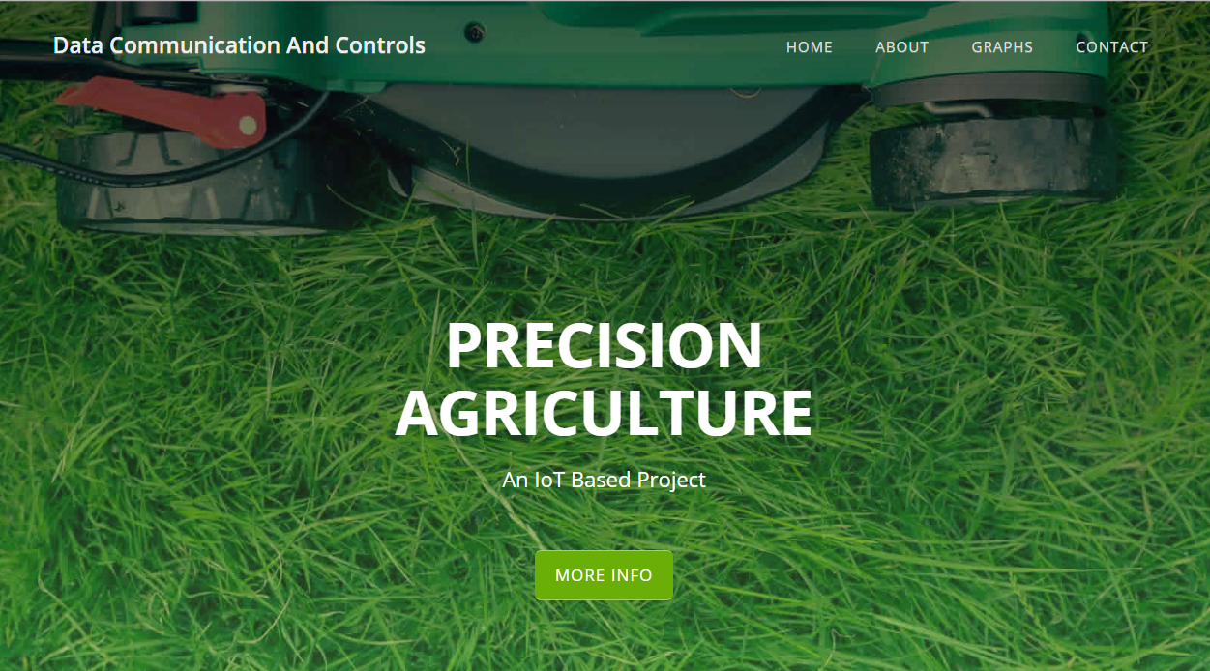
Website Interface

Slide 19
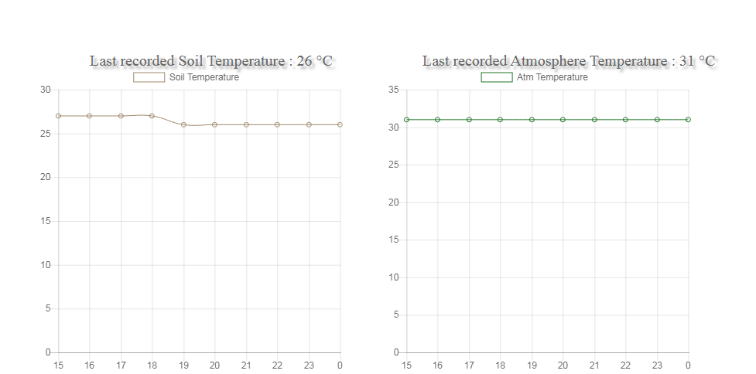
Website Interface

Slide 20
Path Forward
Connecting the Hub to MySQL database via Wi-Fi.
Setting up an Arduino controlled water valve.
Prototype Designing.

Slide 21
Timeline
Week-1: Introduction and Study of Embedded Systems
Week-2: Study of Internet of Things (IoT), Precision Agriculture and Project Planning
Week-3: Development
Week 4: Complete the Development
Week 5: Conclusion, Demo & Presentation

Slide 22
Thank You.

